Slide 1
Introduction To Compiler
Course Code: CSC 3220
Course Title: Compiler Design
Dept. of Computer Science
Faculty of Science and Technology
Lecturer No: | 3 | Week No: | 3 | Semester: | Summer 20_21
Lecturer: | Nazia Hossain; nazia@aiub.edu

Slide 2
Lecture Outline
Phases of a Compiler
Practice on Different Input Expressions
Linker and Loader
Front end and Back end of a compiler
Symbol Table Management
Error Handler

Slide 3
Objectives and Outcomes
Objectives:
Understand the Structure of a compiler
Understand the tools involved( Scanner generator, Parser generator, etc)
Outcome:
Students will be able to represent the simulation of all phases of a compiler for inputs.

Slide 4
The Phases of a Compiler
Intermediate Code generator: After syntax and semantic analysis of the source program, many compilers generate an explicit low-level or machine-like intermediate representation, which we can think of as a program for an abstract machine. This intermediate representation should have two important properties:
Easy to Produce and
Easy to translate into target program
The intermediate representation can have a variety of forms. In this course we consider an intermediate form called “ three address code”.

Slide 5
The Phases of a Compiler
We need to follow some steps to generate three address code.
Each three address instruction has at most one operator on the right side.
The compiler must generate a temporary name to hold the value computed by each instruction.
Some three address instructions have fewer than three operands.
So the output of the intermediate code generator will be
:=
(id, 1)
+
temp1 := inttofloat(60)
temp2 := id3 * temp1
temp3 := id2 + temp2
id1 := temp3
(id,2)
*
(id,3)
inttofloat
60

Slide 6
The Phases of a Compiler
Code Optimizer: The machine-independent code-optimization phase attempts to improve the intermediate code so that better target code will result.
Find More Efficient Ways to Execute Code
Replace Code With More Optimal Statements
Significantly improve the running time of the target program
So this phase optimized the code and produced the output as follows
temp1 := inttofloat(60)
temp2 := id3 * temp1
temp3 := id2 + temp2
id1 := temp3
temp1 := id3 * 60.0
id1 := id2 + temp1

Slide 7
The Phases of a Compiler
Code Generator: The final phase of the compiler is to generate code for a specific machine. In this phase we consider:
memory management
register assignment
The output from this phase is usually assembly language or relocatable machine code.
MOVF R2,id3
MULF R2,#60.0
MOVF R1,id2
ADDF R1, R2
MOVF id1,R1
temp1 := id3 * 60.0
id1 := id2 + temp1

Slide 8
Reviewing the Entire Process
position := initial + rate * 60
lexical analyzer
id1 := id2 + id3 * 60
syntax analyzer
:=
id1
+
id2
*
id3
60

Slide 9
Reviewing the Entire Process
Semantic analyzer
:=
id1
+
*
id2l
id3
inttofloat
60
intermediate code generator
temp1 := inttoreal(60)
temp2 := id3 * temp1
temp3 := id2 + temp2
id1 := temp3

Slide 10
Reviewing the Entire Process
code optimizer
temp1 := id3 * 60.0
id1 := id2 + temp1
code generator
MOVF R2,id3
MULF R2,#60.0
MOVF R1,id2
ADDF R1, R2
MOVF id1,R1

Slide 11
Exercises
Find the output for the following expressions
x=a*b+c-10
Y= b+c-d+20

Slide 12
Linker and Loader
Linker: A linker, also called link editor or binder, is a program that combines the object modules to form an executable program. In general , in case of a large program, programmers prefer to break the code in to smaller modules, as this simplifies the programming task. Eventually, when the source code of all the modules has been converted in to object code, all the modules need to be put together, which is done by the linker

Slide 13
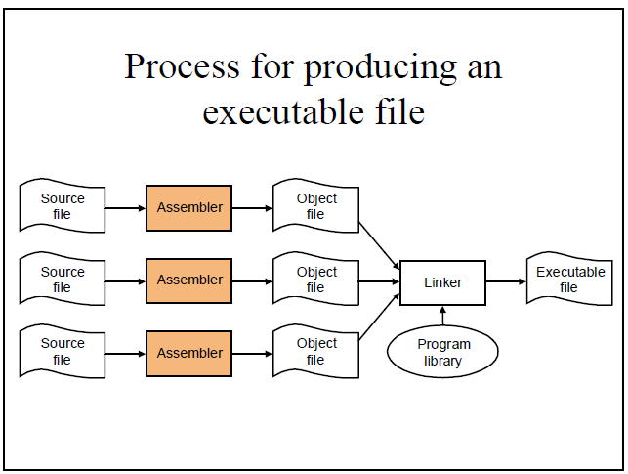

Slide 14
Loader
A loader is a special type of a program that copies programs from a storage device to the main memory, where they can be executed.

Slide 15
Front end and Back end of a Compiler
Front end:
Lexical Analyzer
Syntax Analyzer
Semantic Analyzer
Intermediate Code Generator
Back end :
V. Code Optimizer
VI. Code Generator

Slide 16
Advantages of Using Front-end and Back- end
Retargeting: Build a compiler for a new machine by attaching a new code generator to an existing front-end
Optimization: Reuse intermediate code optimizers in compilers for different languages and different machines.

Slide 17
Symbol Table Management
A symbol table is a data structure containing all the identifiers (i.e. names of variables, procedures etc.) of a source program together with all the attributes of each identifier.
For variables, typical attributes include:
its type,
how much memory it occupies,
its scope.
For procedures and functions, typical attributes include:
the number and type of each argument (if any),
the method of passing each argument, and
the type of value returned (if any).

Slide 18
Symbol Table Management
The purpose of the symbol table is to provide quick and uniform access to identifier attributes throughout the compilation process. Information is usually put into the symbol table throughout the analysis phase and used for the synthesis phase.

Slide 19
Error Handler
Each of the six phases (but mainly the analysis phases) of a compiler can encounter errors. On detecting an error the compiler must:
report the error in a helpful way,
correct the error if possible, and
continue processing (if possible) after the error to look for further errors.

Slide 20
Lecture References
A. Aho, R. Sethi and J. Ullman, Compilers: Principles, Techniques and Tools
(The Dragon Book), [ Second Edition]

Slide 21
References
A. Aho, R. Sethi and J. Ullman, Compilers: Principles, Techniques and Tools(The Dragon Book), [ Second Edition]
Principles of Compiler Design (2nd Revised Edition 2009) A. A. Puntambekar
Basics of Compiler Design Torben Mogensen

